Slide 1

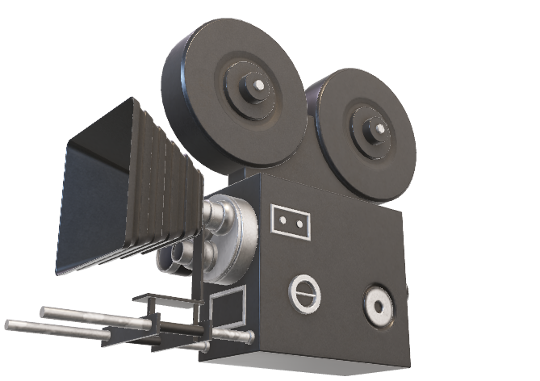
So, you want to make movies?
We are here to help ☺

Slide 2
Business Understanding
Box Office Analysis
Content Production Insights
Established Studios
Results and Recommendations
Genres by Revenue
Risk versus Reward ← Area of focus
Timing of Release
Consult/Partnership
Next Steps
Film Company Production

Slide 3
Sources of Data
Kaggle: Movie Data
Movie Production Studios
Movie Budgets
Measure 5000 films from 2008-2023

Slide 4
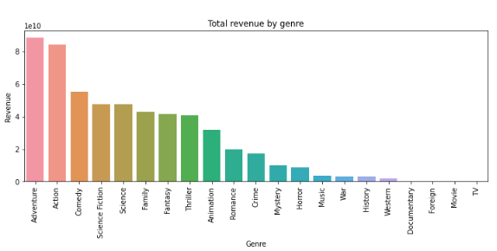

Slide 5

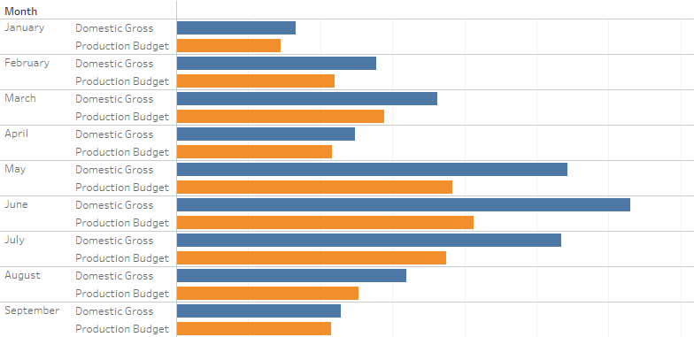

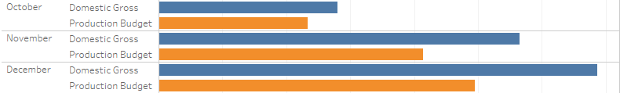
Revenue Generation by Month

Slide 6
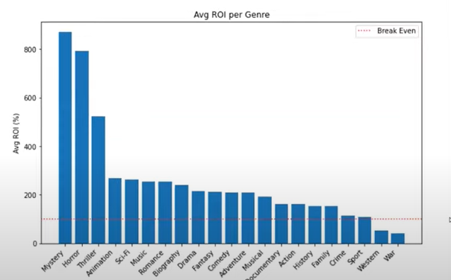



Slide 7
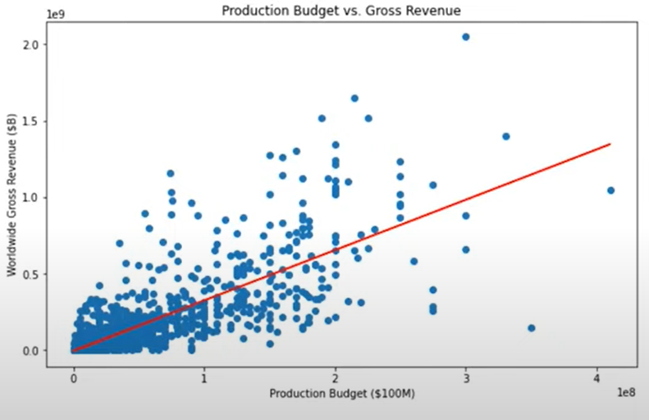
Revenue versus Budget

Slide 8

Average Costs of Starting a Film Production Company
Small Film Company | $10,000 - $50,000
Medium Film Company | $50,000 - $100,000
Large Film Company | $1,000,000 +

Slide 9
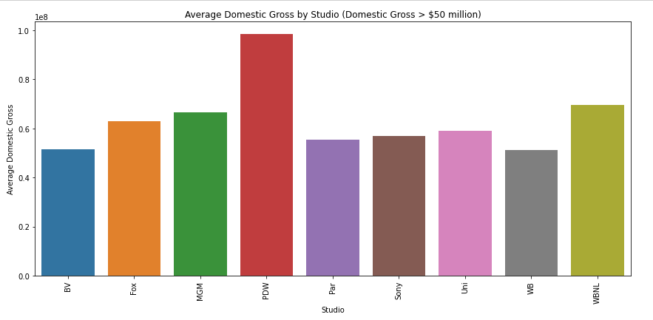

Slide 10




Conclusion
Horror, Mystery, Thriller, Animation
Partner up with established companies
Low Risk, High Reward

Slide 11

Thank You
Johnathan Yaterjo
&
Lotus Baumgarner

